Slide 1
Java Collection Framework Hierarchy
As we have learned Java collection framework includes interfaces and classes. Now, let us see the Java collections framework hierarchy.

Slide 2
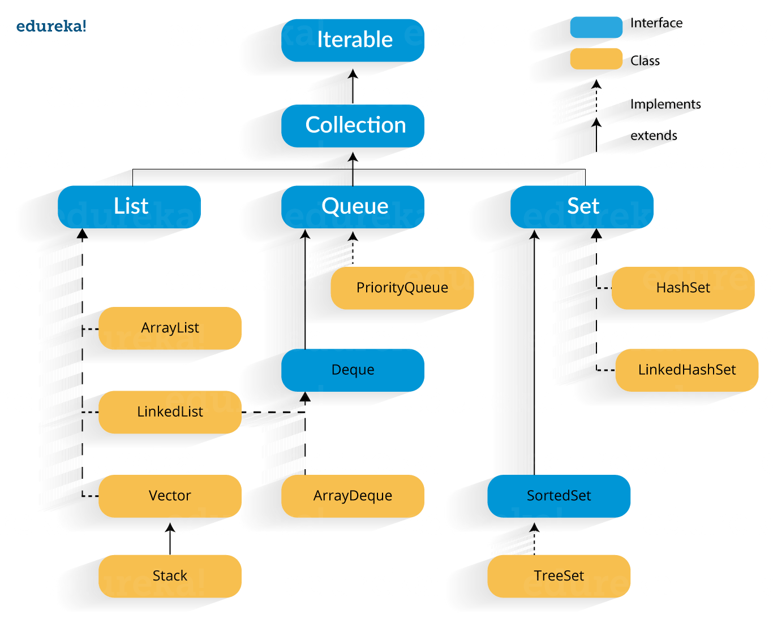

Slide 3
In the above image, blue part refers to the different interfaces and the yellow part defines the class. Now, let us understand these components in detail.
Java Collections : Interface
Iterator interface : Iterator is an interface that iterates the elements. It is used to traverse the list and modify the elements. Iterator interface has three methods which are mentioned below:
public boolean hasNext() – This method returns true if the iterator has more elements.
public object next() – It returns the element and moves the cursor pointer to the next element.
public void remove() – This method removes the last elements returned by the iterator.
There are three components that extend the collection interface i.e List, Queue and Sets. Let’s learn about them in detail:
Java collections: List
A List is an ordered Collection of elements which may contain duplicates. It is an interface that extends the Collection interface. Lists are further classified into the following:

Slide 4
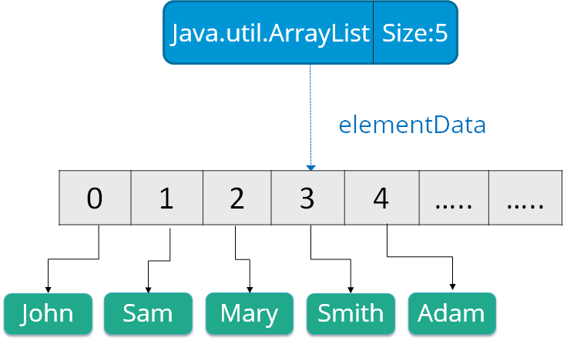
ArrayList
LinkedList
Vectors
Let’s go into detail on each one of them:
Array list: ArrayList is the implementation of List Interface where the elements can be dynamically added or removed from the list. Also, the size of the list is increased dynamically if the elements are added more than the initial size.

Slide 5
Syntax:
ArrayList object = new ArrayList ();
Some of the methods in array list are listed below:
Method | Description
boolean add(Collection c) | Appends the specified element to the end of a list.
void add(int index, Object element) | Inserts the specified element at the specified position.
void clear() | Removes all the elements from this list.
int lastIndexOf(Object o) | Return the index in this list of the last occurrence of the specified element, or -1 if the list does not contain this element.
Object clone() | Return a shallow copy of an ArrayList.
Object[] toArray() | Returns an array containing all the elements in the list.
void trimToSize() | Trims the capacity of this ArrayList instance to be the list’s current size.

